Slide 1

A tutorial for Tracts
Simon Gravel

Slide 2
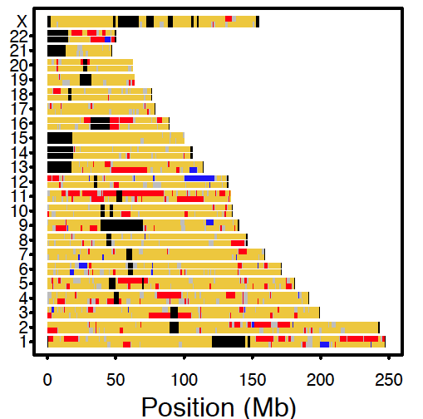
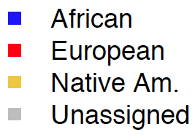
tracts goal
Find best-fitting gene flow models to observed patterns of local ancestry
More specifically, model the distribution of ancestry tract lengths

Slide 3
Background
Most individuals derive a substantial proportion of their recent ancestry to two or more statistically distinct populations.
When the populations are distinct enough, it is possible to infer the local ancestry along the genome.
Available methods: HapMix, Lamp, PCAdmix Saber, SupportMix, …

Slide 4
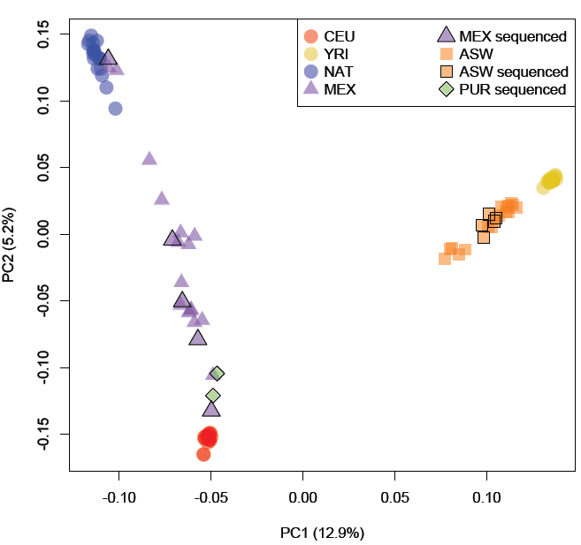
Typical setup for local ancestry inference
Panel individuals are proxies for source population
The panel individuals are likely to be admixed themselves, and there is no clear cutoff. In the following, “Admixed” simply means the samples for which we are attempting the local ancestry inference.
Panel individuals
“Admixed” individuals

Slide 5
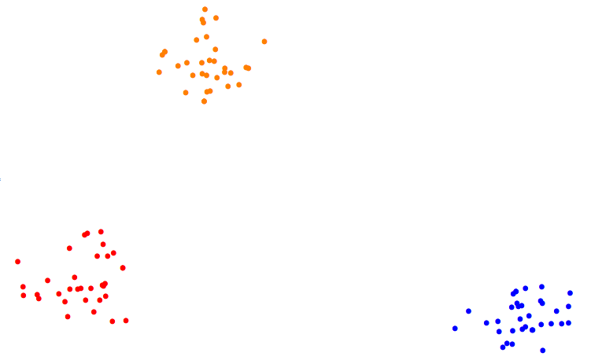
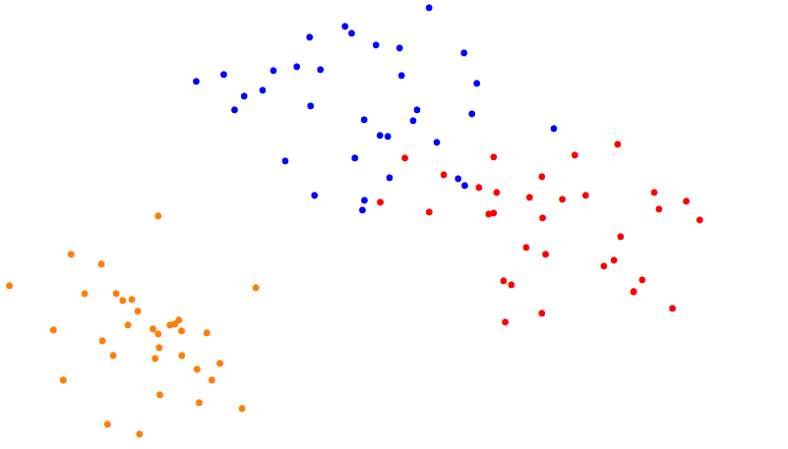
PCAdmix: local ancestry assignment using PCA by window+HMM
Best case scenario:
panels well-separated, sample clusters with one
Panel 1
Sample
Panel 2
Panel 3
More typical case (if we’re lucky)
Panel 3
Sample
Panel 1
Panel 2
Kidd*, Gravel* et al (in Review)

Slide 6
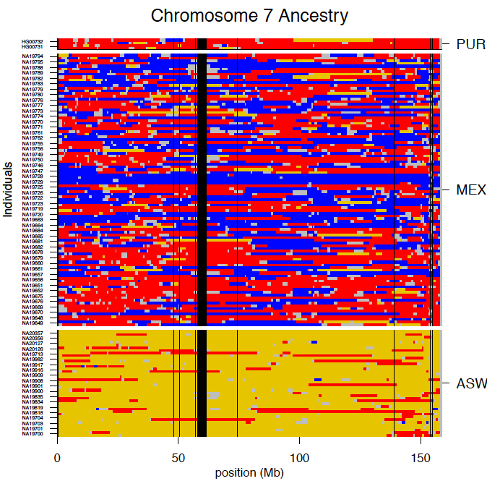
Modeling the admixture process
Kidd*, Gravel* et al (in Review)

Slide 7
Tracts assumptions
Local ancestry assignments are accurate hard calls. In PCAdmix, this means using a Viterbi decoding algorithm.
The “admixed” population is a panmictic population, without population structure.
Recombination is uniform across populations.
Little drift since admixture began.

Slide 8
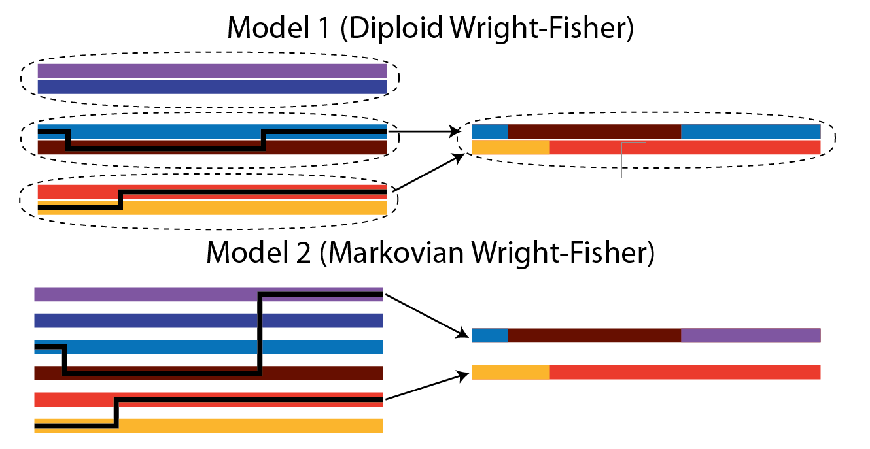
Recombination model in tracts
tracts uses a simplified Markovian model of recombination.
This is the approximation of least concern.

Slide 9
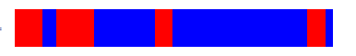
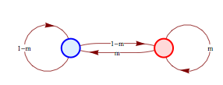
Modeling ancestry tracts using a Markov model: migration pulse
A simulated chromosome with local assignments
T₁
Each recombination occurs independently, giving rise to a Markov Model
Gravel (in Review)

Slide 10
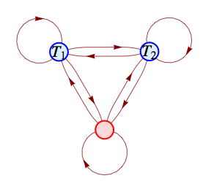
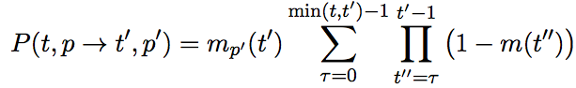
More complex demographic histories can be modeled via multiple-state Markov model
T₁
T₂
The entire demographic history contained in the transition matrix. tracts calculates it for you

Slide 11
Markov model vs simulation
Gravel (in Review)

Slide 12
The goal is now to use real data, generate these histograms, fit some demographic models

Slide 13
Assuming you have already run a local ancestry inference method
The day starts with bed files containing the local ancestry calls:
We tend to use Rfmix (http://www.cell.com/ajhg/abstract/S0002-9297(13)00289-9)
chrom begin end assignment cmBegin cmEnd
chr13 0 18110261 UNKNOWN 0.0 0.19
chr13 18110261 28539742 YRI 0.19 22.193
chr13 28539742 28540421 UNKNOWN 22.193 22.193
chr13 28540421 91255067 CEU 22.193 84.7013

Slide 14
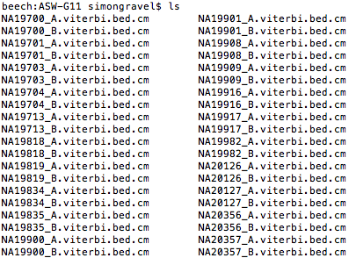
Organizing files in a directory
We suppose that genomes are phased. One way to organize this is to have two bed files per individual (_A and _B), and have individuals in a directory:

Slide 15
tracts is object-oriented.
definitions in tracts.py
tract<chrom<chropair<indiv<population
import complete population and calculate statistics:
pop=tracts.population(names=names, fname=(directory,"",".viterbi.bed.cm"), selectchrom=chroms)
(bins, data)=pop.get_global_tractlengths(npts=50)

Slide 16
Defining a model
tracts can take arbitrary time-dependent migration rates m from K populations. Migrations rates are organized as an array:
populations k/K
generations
t/T
m_{tk}
Way too many parameters to optimize!!

Slide 17
Defining a model
We need to choose a model with a short vector of parameters a, and define a function
def f(a):
Return KxT migration array
def control(a):
Return < 0 if parameters outside range
Tons of 2- and 3-pop models are pre-defined, I’m happy to help with model-building.

Slide 18
Optimization steps
decide of the starting conditions for the parameters
startparams=numpy.array([ 0.897887 , 0.172344 , 0.922907 , 0.120098 , 0.111489 , 0.05883 ])
decide how many bins of short tracts to ignore (cutoff typically 1 or 2)
You’re all set:
xopt=tracts.optimize_cob(startparams,bins,Ls,data,nind,func,outofbounds_fun=bound,cutoff=1,epsilon=1e-2)
Hopefully, tracts will return data in a number of text files. You can specify the exact text files in the python driver, but the basic outputs are presented on next page:

Slide 19
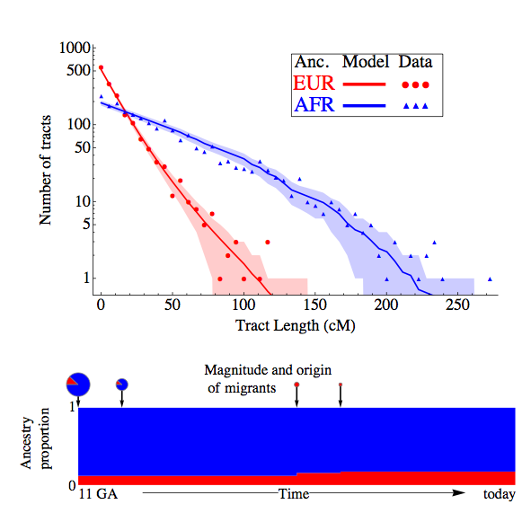
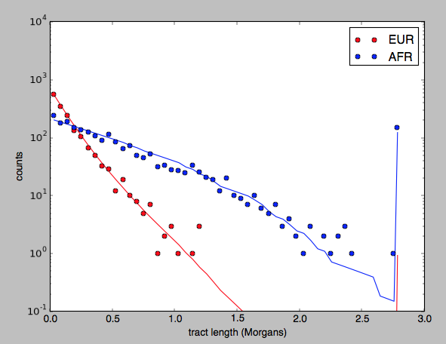
Output files
The exemple files produce 5 output files, e.g.
taino_ppp_xxp_boot0_-228.57_bins
taino_ppp_xxp_boot0_-228.57_dat
taino_ppp_xxp_boot0_-228.57_pred
taino_ppp_xxp_boot0_-228.57_mig
taino_ppp_xxp_boot0_-228.57_pars
In this example, “ppp_xxp” is the name of the model used to fit the data
boot0 means that this is bootstrap iteration 0, which in the convention used here means the fit with the real data
-228.57 is the likelihood of the best-fit model
_bins contains the bins used in the discretization
_dat are the observed counts in each bins
_pred are the predicted counts in each bin, according to the model
_mig is the inferred migration matrix, with the most recent generation at the top, and one column per migrant population
_pars are the optimal parameters
These files provide the necessary information to produce a plot like this one:
Unfortunately, I could not figure out how to such nice a plot in python, so I
provided a Mathematica script (SimpleTractPlots) to do this. Unfortunately,
Mathematica is not free. You can get a plot from python using the functions
provided in tracts (see
ASW_tractlengths_fix for an
example:

Slide 20
If optimization fails to reliably converge
Use improved optimizer: optimize_cob_fracs
Restart with different starting parameters…

Slide 21
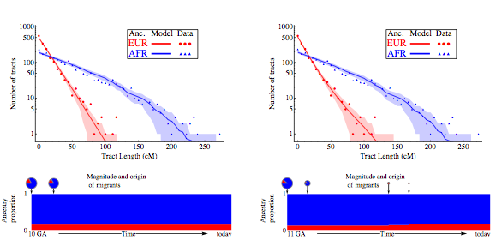
Comparing different models
Use a nested models and perform a likelihood ratio test

